Slide 1
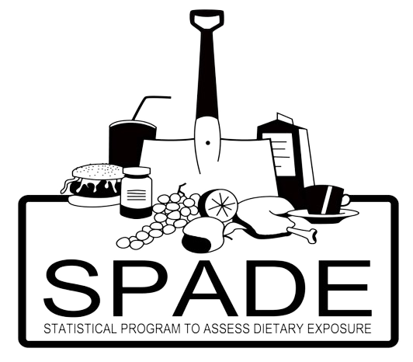
Different models in SPADE
Which one to use?

Slide 2
Prior check: is SPADE suitable?
No results for
regression calibration,
also called 'individual' habitual intakes
Scope: population habitual (usual) intake distribution
Data: sufficient subjects with ≥2 independent days with ≥2 positive intakes (on separate rows)
Data: mandatory variables → id, sex, age (page 21 manual, some tips if data does not contain age or sex info)
Outcome: Single variable per analysis
→ multiple variables with correlation not possible

Slide 3
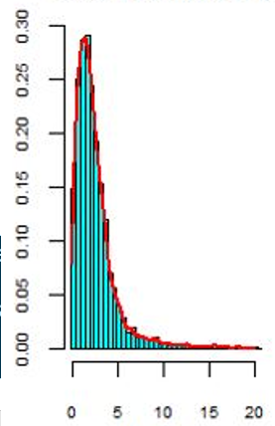
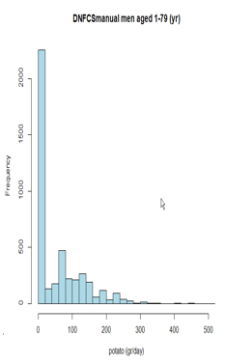
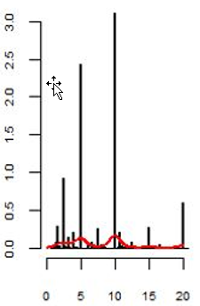
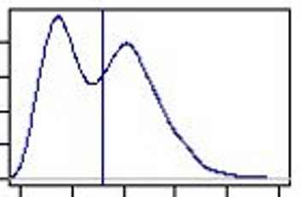
Model selection within SPADE
Histograms of the data can help to select the right model
Regular foods and drinks
Dietary supplements
Nutrients added to foods or drinks (fortification)
Bimodal distribution
Bad approach: model(source_1 + source_2) Better:
model(source_1) + model(source_2) (first shrink then add)
Continuous distributions
Spiked distribution

Slide 4
Model selection within SPADE
How many sources of the intake variable do you want to model separately?

Slide 5
Model selection within SPADE
How many sources of the intake variable do you want to model separately?
1
≥2
Intake from dietary supplements?

Slide 6
Model selection within SPADE
How many sources of the intake variable do you want to model separately?
1
≥2
Intake from dietary supplements?
Dietary supplements are concentrated sources of nutrients, with non-continuous amounts, need special treatment in analyses
Verkaik-Kloosterman et al. 2011 J Nutr; 141(11):2055-63

Slide 7
Model selection within SPADE
How many sources of the intake variable do you want to model separately?
1
≥2
Intake from dietary supplements?
Dietary supplements are concentrated sources of nutrients, with non-continuous amounts, need special treatment in analyses
Verkaik-Kloosterman et al. 2011 J Nutr; 141(11):2055-63

Slide 8
Model selection within SPADE
How many sources of the intake variable do you want to model separately?
1
≥2
Intake from dietary supplements?
no
yes
Daily intakes?

Slide 9
Model selection within SPADE
How many sources of the intake variable do you want to model separately?
1
≥2
Intake from dietary supplements?
no
yes
Daily intakes?
yes
no
Notes:
Page 15 manual: SPADE has a build in warning/error for too many zero’s when using the 1-part model. < 5% zero SPADE will run. >10% zero SPADE generates error with recommendation to use 2-part model. Between 5-10% SPADE will run, but generates a warning that perhaps a 2-part model is more suitable. The proportions 5% and 10% are rule of thumbs based on? Limited data is available to know exact with how many zero’s you can still run the 1-part model.

Slide 10
Model selection within SPADE
How many sources of the intake variable do you want to model separately?
1
≥2
Intake from dietary supplements?
no
yes
Daily intakes?
yes
no

Slide 11
Model selection within SPADE
How many sources of the intake variable do you want to model separately?
1
≥2
Intake from dietary supplements?
no
yes
Daily intakes?
yes
no
Daily intakes = nutrient/food consumed by virtually whole population on every day
SPADE generates a warning or an error when large proportion of zero intakes in survey

Slide 12
Model selection within SPADE
How many sources of the intake variable do you want to model separately?
1
≥2
Intake from dietary supplements?
no
yes
Daily intakes?
yes
no
Daily intakes = nutrient/food consumed by virtually whole population on every day
SPADE generates a warning or an error with large proportion of zero intakes in survey
SPADE for daily intakes
chapter 3

Slide 13
Model selection within SPADE
Number of sources of intake variable
1
≥2
Intake from dietary supplements?
no
Daily intakes?
yes
no
SPADE for daily intakes
chapter 3

Slide 14
Model selection within SPADE
Number of sources of intake variable
1
≥2
Intake from dietary supplements?
no
Daily intakes?
yes
no
Never consumers?
no
SPADE for daily intakes
chapter 3

Slide 15
Model selection within SPADE
Number of sources of intake variable
1
≥2
Intake from dietary supplements?
no
Daily intakes?
yes
no
Never consumers?
no
SPADE for daily intakes
chapter 3
SPADE for episodical intakes
chapter 4

Slide 16
Model selection within SPADE
Number of sources of intake variable
1
≥2
Intake from dietary supplements?
no
Daily intakes?
yes
no
Never consumers?
no
Episodical intakes are not every day consumed by most of the pariticipants (like potatoes)
SPADE assumes here that all participants are potential consumers even if a person has only zero intakes in the survey
SPADE for daily intakes
chapter 3
SPADE for episodical intakes
chapter 4

Slide 17
Model selection within SPADE
Number of sources of intake variable
1
≥2
Intake from dietary supplements?
no
Daily intakes?
yes
no
Never consumers?
no
yes
SPADE for daily intakes
chapter 3
SPADE for episodical intakes
chapter 4
Episodical intakes + never consumers
chapter 4.3
Episodical intakes AND extra information
(e.g. Food Frequency Questionaire) : participant is
a consumer or a never consumer
The habitual intake of a (confirmed) never consumer is zero

Slide 18
Model selection within SPADE
Number of sources of intake variable
1
≥2
Intake from dietary supplements?
no
Daily intakes?
yes
no
Never consumers?
no
yes
SPADE for daily intakes
chapter 3
SPADE for episodical intakes
chapter 4
Episodical intakes + never consumers
chapter 4.3

Slide 19
Model selection within SPADE
Number of sources of intake variable
1
≥2
Intake from dietary supplements?
no
yes
Daily intakes?
yes
no
Never consumers?
no
yes
SPADE for daily intakes
chapter 3
SPADE for episodical intakes
chapter 4
Episodical intakes + never consumers
chapter 4.3

Slide 20
Model selection within SPADE
Number of sources of intake variable
1
≥2
Intake from dietary supplements?
no
yes
Daily intakes?
yes
no
Never consumers?
no
yes
SPADE for daily intakes
chapter 3
SPADE for episodical intakes
chapter 4
Episodical intakes + never consumers
chapter 4.3
Episodical intakes supplements only
chapter 5

Slide 21
Model selection within SPADE
Number of sources of intake variable
1
≥2
Intake from dietary supplements?
Intake from 2 sources,
of which 1 is dietary supplements?
no
yes
Daily intakes?
yes
no
Never consumers?
no
yes
SPADE for daily intakes
chapter 3
SPADE for episodical intakes
chapter 4
Episodical intakes + never consumers
chapter 4.3
Episodical intakes supplements only
chapter 5

Slide 22
Model selection within SPADE
Number of sources of intake variable
1
≥2
Intake from dietary supplements?
Intake from 2 sources,
of which 1 is dietary supplements?
no
yes
Daily intakes?
yes
no
yes
no
preferred
Never consumers?
no
yes
SPADE for daily intakes
chapter 3
SPADE for episodical intakes
chapter 4
Episodical intakes + never consumers
chapter 4.3
Episodical intakes supplements only
chapter 5

Slide 23
Model selection within SPADE
Number of sources of intake variable
1
≥2
Intake from dietary supplements?
Intake from 2 sources,
of which 1 is dietary supplements?
no
yes
Daily intakes?
yes
no
yes
no
preferred
Never consumers?
no
yes
SPADE for daily intakes
chapter 3
SPADE for episodical intakes
chapter 4
Episodical intakes + never consumers
chapter 4.3
Episodical intakes supplements only
chapter 5
SPADE for intakes from food and supplements
chapter 6

Slide 24
Model selection within SPADE
Number of sources of intake variable
1
≥2
Intake from dietary supplements?
Intake from 2 sources,
of which 1 is dietary supplements?
no
yes
Daily intakes?
yes
no
This model combines * Daily/episodical with * supplement model but separate analyses for users and non-users of supplements
yes
no
preferred
Never consumers?
no
yes
SPADE for daily intakes
chapter 3
SPADE for episodical intakes
chapter 4
Episodical intakes + never consumers
chapter 4.3
Episodical intakes supplements only
chapter 5
SPADE for intakes from food and supplements
chapter 6

Slide 25
Model selection within SPADE
Number of sources of intake variable
1
≥2
Intake from dietary supplements?
Intake from 2 sources,
of which 1 is dietary supplements?
no
yes
Daily intakes?
yes
no
This model combines * Daily/episodical food with * supplement model but separate analyses for users and non-users of supplements
yes
no
preferred
Never consumers?
no
yes
SPADE for daily intakes
chapter 3
SPADE for episodical intakes
chapter 4
Episodical intakes + never consumers
chapter 4.3
Episodical intakes supplements only
chapter 5
SPADE for intakes from food and supplements
chapter 6
SPADE for multiple sources
chapter 7

Slide 26
Model selection within SPADE
Number of sources of intake variable
1
≥2
Intake from dietary supplements?
Intake from 2 sources,
of which 1 is dietary supplements?
no
yes
Daily intakes?
yes
no
yes
no
preferred
Never consumers?
no
yes
SPADE for daily intakes
chapter 3
SPADE for episodical intakes
chapter 4
Episodical intakes + never consumers
chapter 4.3
Episodical intakes supplements only
chapter 5
3-part model
chapter 6
SPADE for multiple sources
chapter 7
SPADE for intakes from food and supplements
chapter 6

Slide 27
Model selection within SPADE
Number of sources of intake variable
1
≥2
Intake from dietary supplements?
Intake from 2 sources,
of which 1 is dietary supplements?
no
yes
Daily intakes?
yes
no
This model combines * Daily and/or episodical model(s) * neverconsumers model * supplement model
NO separate analyses for users and non-users supplements
yes
no
preferred
Never consumers?
no
yes
SPADE for daily intakes
chapter 3
SPADE for episodical intakes
chapter 4
Episodical intakes + never consumers
chapter 4.3
Episodical intakes supplements only
chapter 5
3-part model
chapter 6
SPADE for multiple sources
chapter 7
SPADE for intakes from food and supplements
chapter 6

Slide 28
Model selection within SPADE
Page 17 of the manual
Number of sources of intake variable
1
≥2
Intake from dietary supplements?
Intake from 2 sources,
of which 1 is dietary supplements?
no
yes
Daily intakes?
yes
no
yes
no
preferred
Never consumers?
no
yes
SPADE for daily intakes
chapter 3
SPADE for episodical intakes
chapter 4
Episodical intakes + never consumers
chapter 4.3
Episodical intakes supplements only
chapter 5
3-part model
chapter 6
SPADE for multiple sources
chapter 7
SPADE for intakes from food and supplements
chapter 6

Slide 29
Model selection within SPADE
Page 17 of the manual
Number of sources of intake variable
1
≥2
Intake from dietary supplements?
Intake from 2 sources,
of which 1 is dietary supplements?
no
yes
Daily intakes?
yes
no
yes
no
preferred
Never consumers?
no
yes
SPADE for daily intakes
chapter 3
SPADE for episodical intakes
chapter 4
Episodical intakes + never consumers
chapter 4.3
Episodical intakes supplements only
chapter 5
3-part model
chapter 6
SPADE for multiple sources
chapter 7
SPADE for intakes from food and supplements
chapter 6
f.spade
f.spade.neverconsumers
f.spade.supplement
f.spade3
f.spade4

Slide 30
In this course
All of them!
Except SPADE for multiple sources
And SPADE for non-daily intakes is optional (but we will give you the bare minimum anyway)
All models available in manual

